Slide 1
Batch Whitening

Slide 2
Status
Generated baselines
EfficientNet B0 on TinyImagenet – (overfit)
EfficientNet B0 on ImageNet
Implemented the BW layer
For FC
For Conv layers
Integrated in EfficientNet
Evaluate the operator on TinyImagenet
https://wandb.ai/guyk1971/efcnt_tin?nw=nwuserguyk1971
Next : hparam sweep
Next: Evaluate on Imagenet

Slide 3
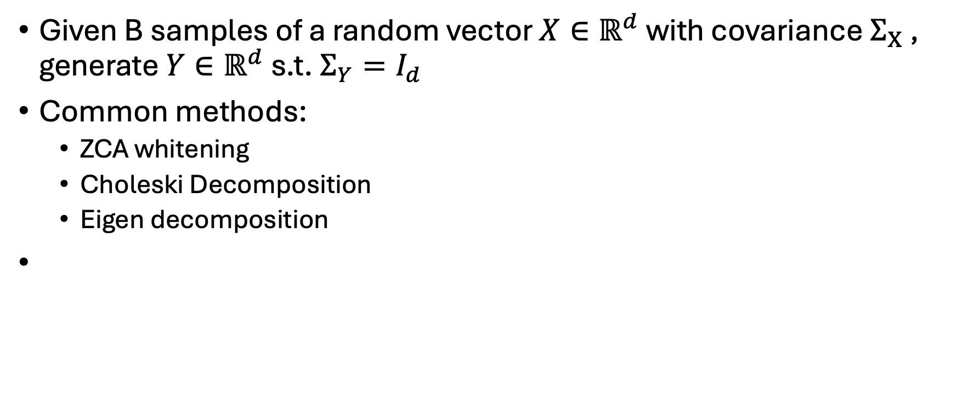
Batch Whitening
Given B samples of a random vector $X∈ℝ^{d}$ with covariance $Σ_{X}$ , generate $Y∈ℝ^{d}$ s.t. $Σ_{Y}=I_{d}$
Common methods:
ZCA whitening
Choleski Decomposition
Eigen decomposition

Slide 4
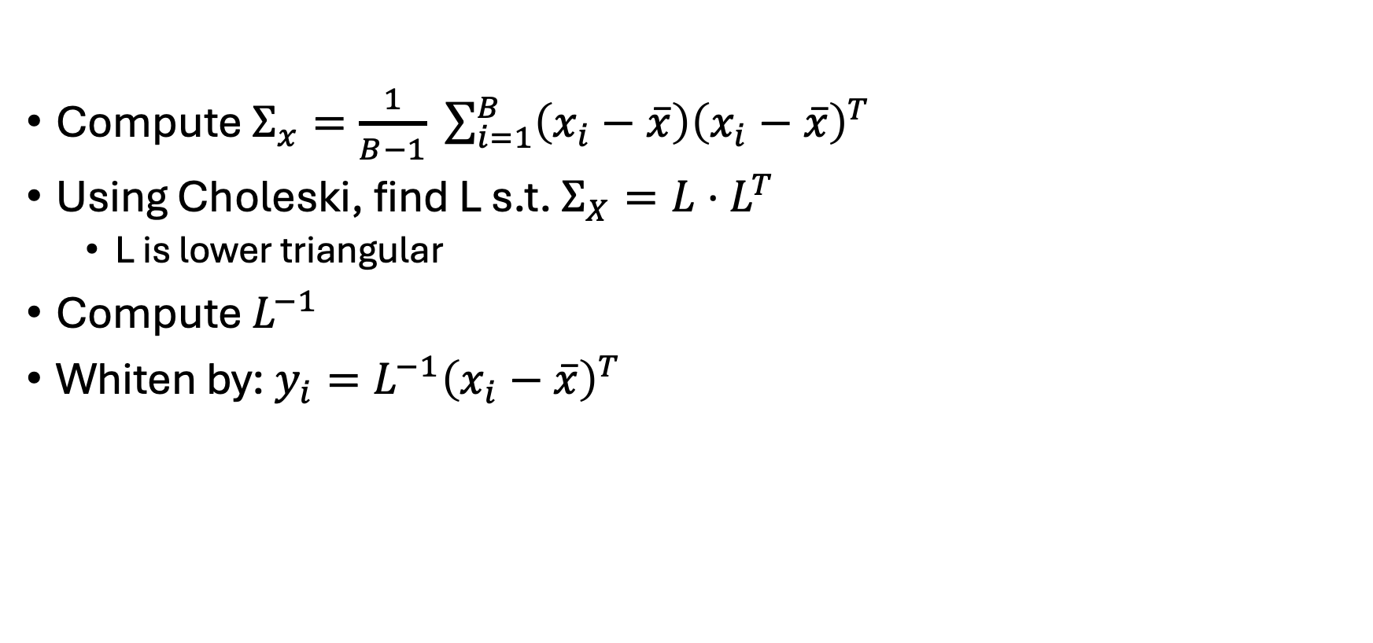
Using Choleski
Compute $Σ_{x}=\frac{1}{B−1} \sum_{i=1}^{B}{\left(x_{i}−\overline{x}\right){\left(x_{i}−\overline{x}\right)}^{T}}$
Using Choleski, find L s.t. $Σ_{X}=L⋅L^{T}$
L is lower triangular
Compute $L^{−1}$
Whiten by: $y_{i}=L^{−1}{\left(x_{i}−\overline{x}\right)}^{T}$

Slide 5
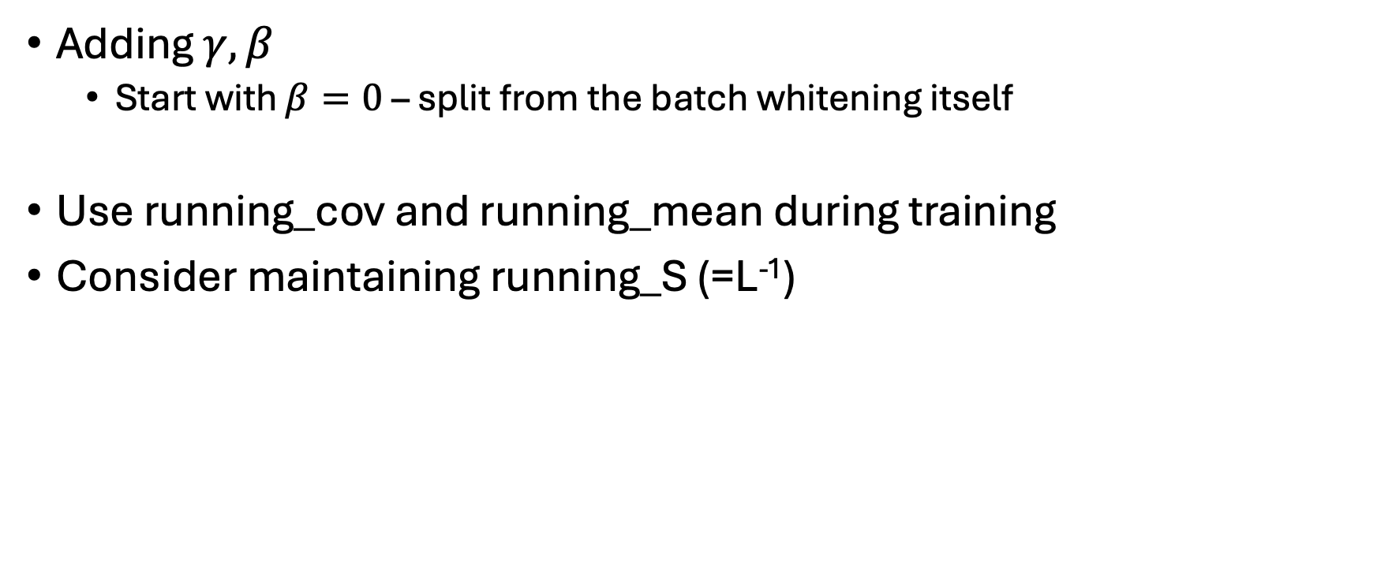
Layer implementation
Adding $γ, β$
Start with $β=0$ – split from the batch whitening itself
Use running_cov and running_mean during training
Consider maintaining running_S (=L⁻¹)

Slide 6
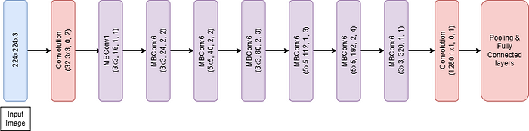
Efficient Net
3 blocks/layers to handle
Conv_stem
MBConv
Proj_conv

Slide 7
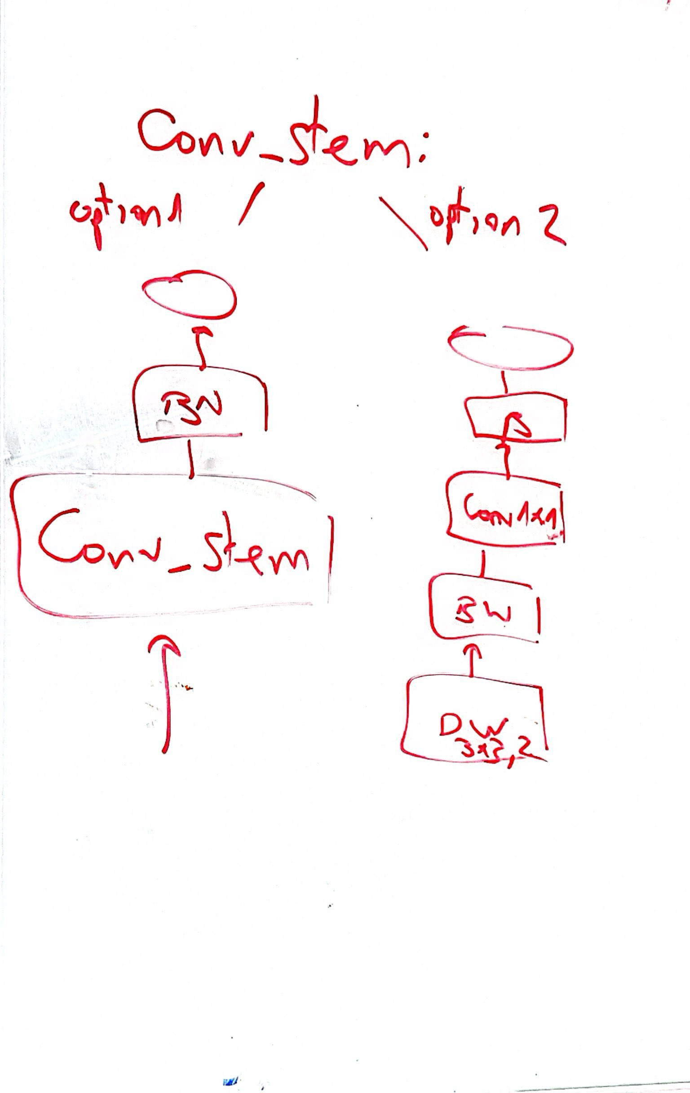
EfficientNet
ConvStem – 2 options
Type 1 (left branch) – no BW. as in original topology
Type 2 (right branch) – with BW

Slide 8
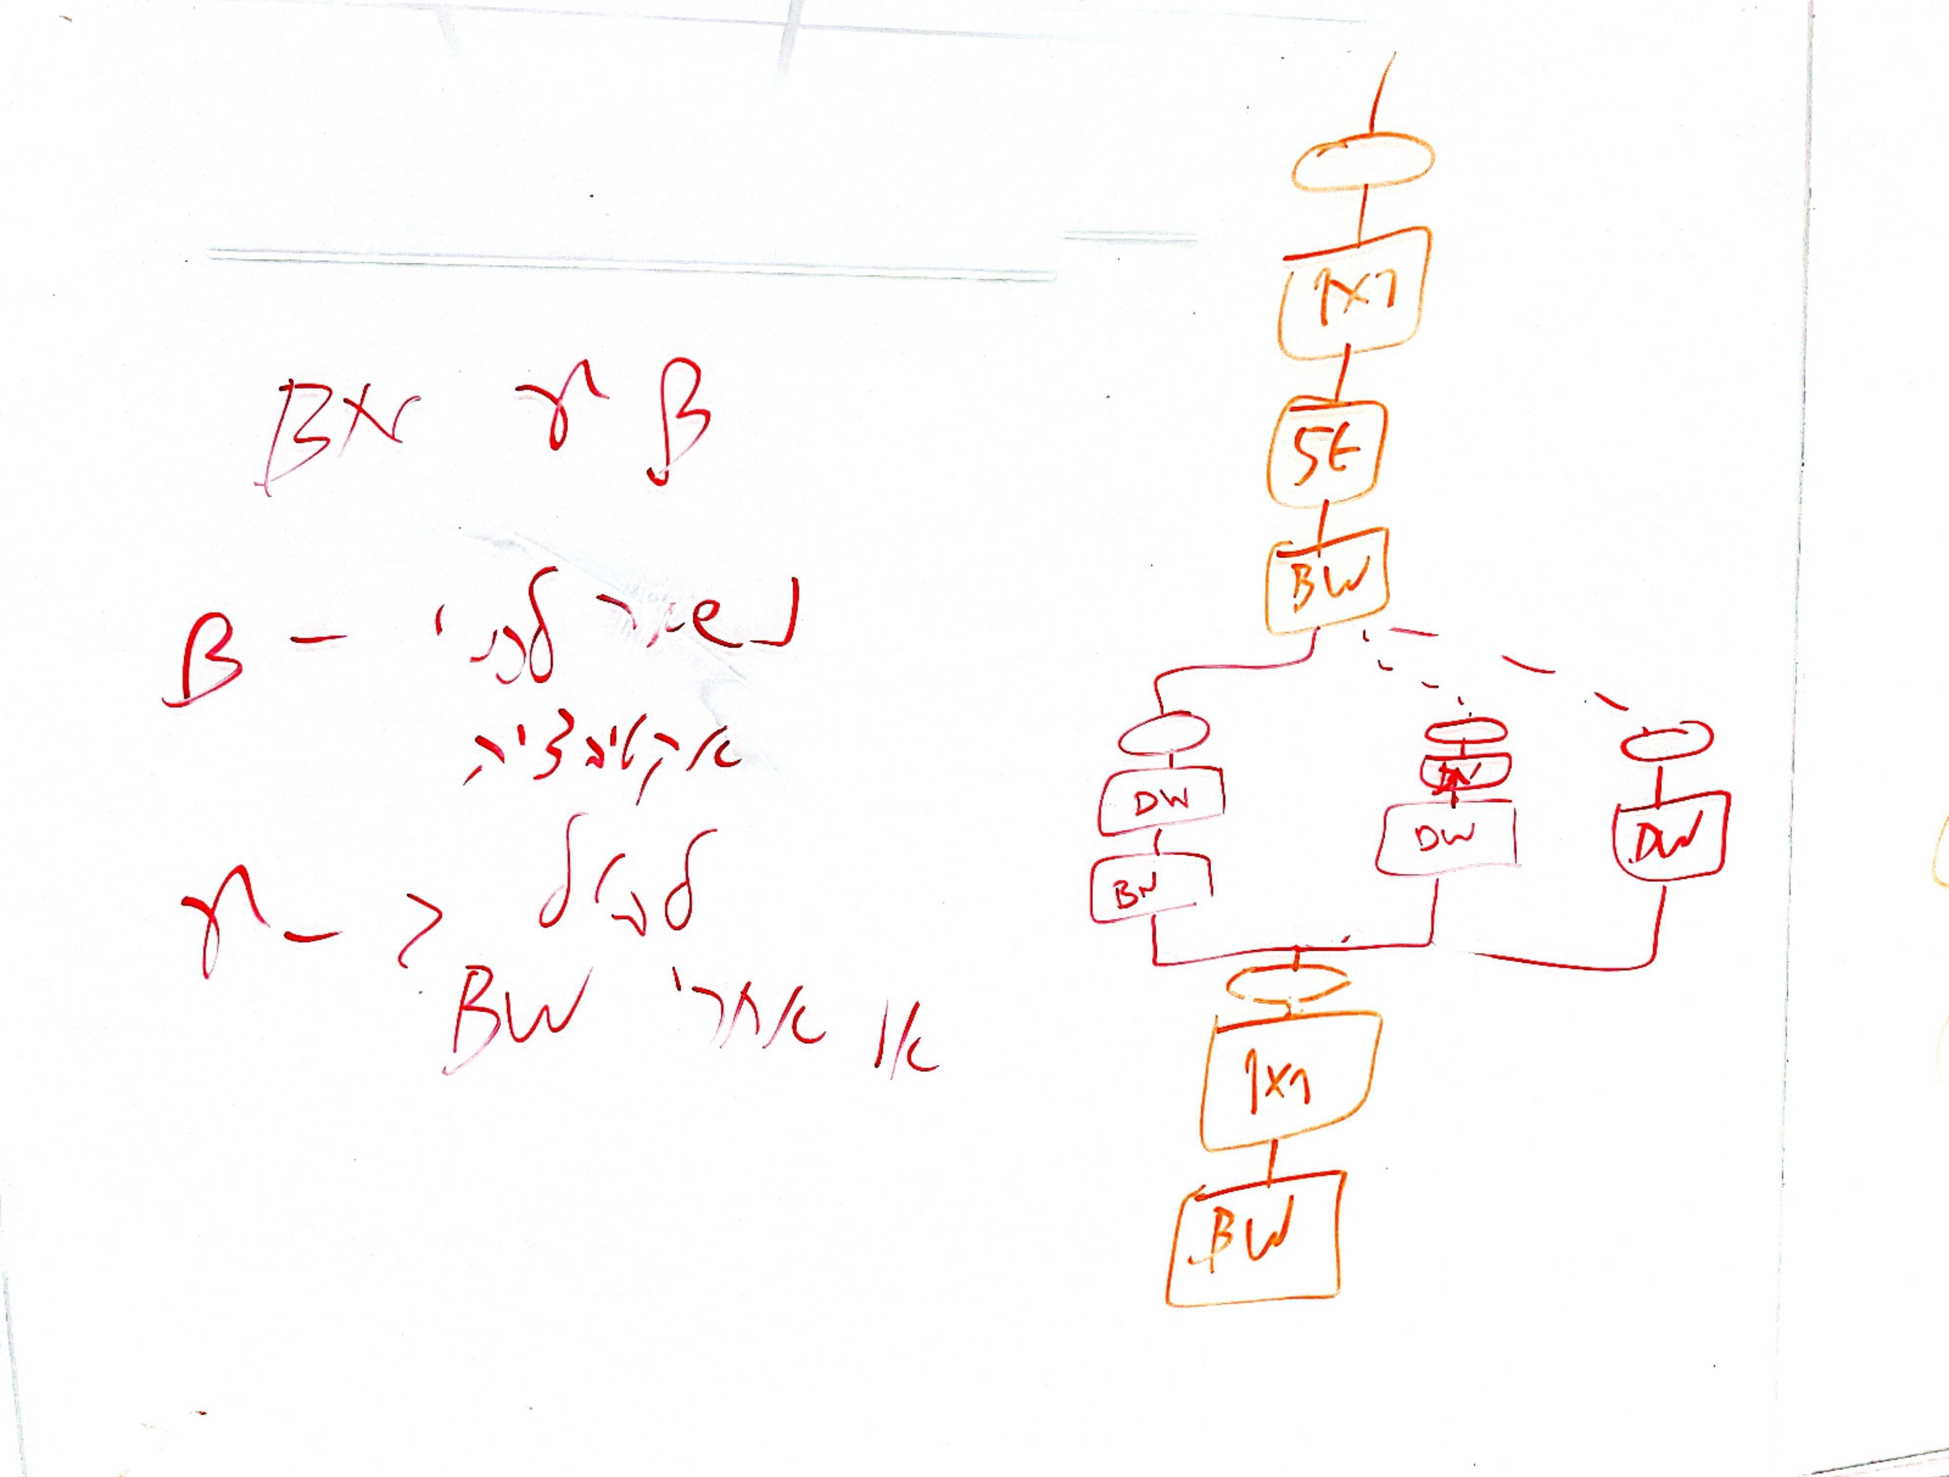
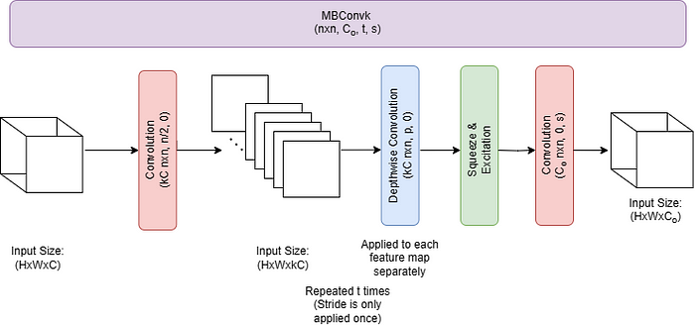
EfficientNet
MBConv – 3 options
1
2
3

Slide 9
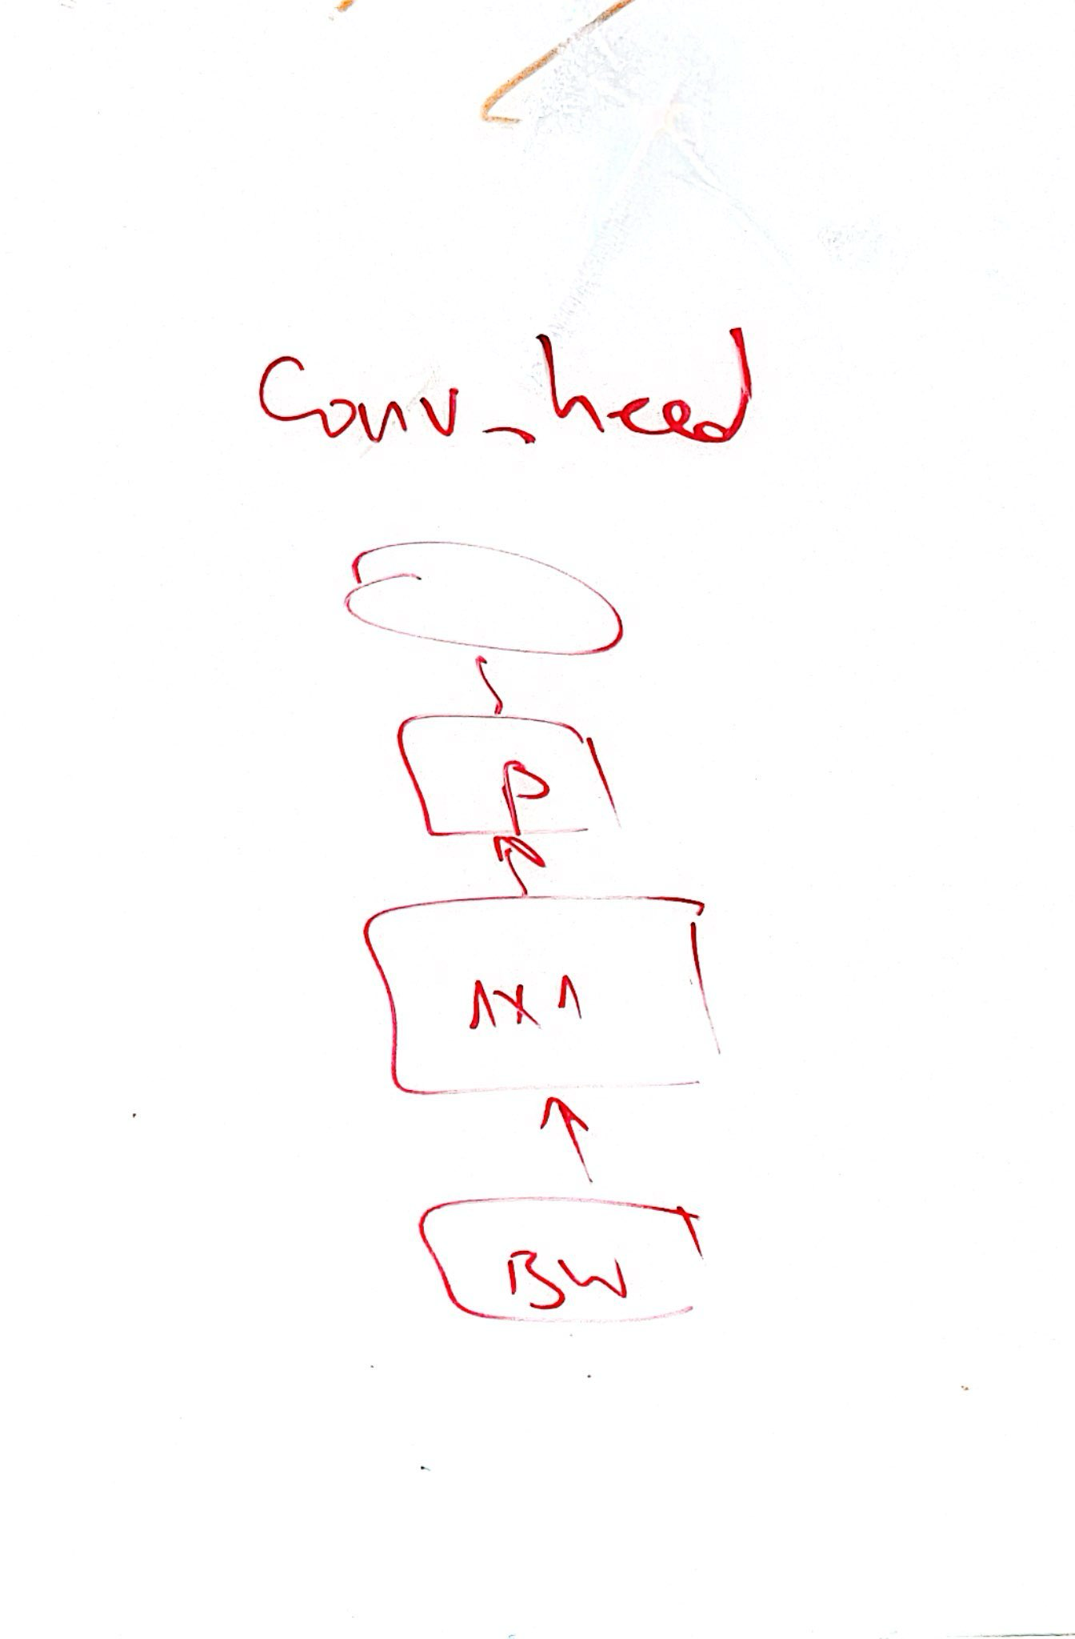
EfficientNet
Conv head

Slide 10
Hyper parameter sweep
Start on tiny imagenet
Mbconv block type {1,2,3}
Conv stem block type {1,2}
Define set of other potentially relevant hyperparms
Perform random search
Try most successful combinations on imagenet

